Slide 1
Saving SALVATION: Does Salvation Mean Anything to Us today?
SUFFOLK THEOLOGY FORUM, IPSWICH, 29 June 2017
Anna Abram, Margaret Beaufort Institute of Theology, Cambridge

Slide 2
St Augustine:
‘All together we are members of Christ and are his body; and not we who are in this place only, but throughout the world; and not at this time only, but – what shall I say – from Abel the just man until the end of time, as long as men beget and are begotten, whoever among the just made his passage through this life, whether now, that is, not in this place, but in the present life, or in generations to come, all the just are one body of Christ, and individually his members’ (Sermo 341:9, 1; PL 39:1499-1500).

Slide 3
Church of England in the ‘Gospel of Salvation’, General Synod’s report, 2010 (https://www.churchofengland.org/media/39745/gsmisc956.pdf )
‘The gospel testifies to the uniqueness of Jesus Christ in God’s plan for the salvation of the world. There can be no greater theme – and no higher calling for the Church than to bear witness to salvation in and through Christ’.
‘Christ’s saving work is not a commodity to be sold but a gift to be shared. If we keep always in mind the central insight that it is not we who bring others to Christ but God working in them, we can avoid colluding with the marketing mindset which would paint every evangelist as a huckster and portray God’s children as ‘targets’ for conversion. When our encounters with our neighbours, of other faiths and none, are distinguished from exercises in salesmanship, we can be confident that we are sharing God’s love rather than marketing another lifestyle choice’.
Salvation and Dialogue (including Inter-religious dialogue)
Witness
Education
Chaplaincy

Slide 4
Catechism of the Catholic Church http://www.vatican.va/archive/ENG0015/_INDEX.HTM
Baptism is necessary for salvation (CCC 1257). This baptism erases original sin (CCC 405), unites the person with Christ (CCC 977), infuses grace into the person (CCC 1999), and grants justification (CCC 1992, 2020).
To maintain salvation, it is necessary to perform good works (CCC 2010, 2068, 2080) and participate in the sacraments (CCC 1129) which provide grace that is "proper to each sacrament" (CCC 1129, 2003). This is necessary in order to maintain infused grace (CCC 987, 1468). However, grace can be lessened by venial sins or completely lost by mortal sins.
Eucharist removes venial sins (CCC 1416). Through the Sacrament of Reconciliation (CCC 980) we can be reconciled with God and with the Church
Justification has been merited for us by the Passion of Christ who offered himself on the cross (CCC 1992)
‘No Salvation Outside the Church’ – ‘How are we to understand this affirmation, often repeated by the Church Fathers? Re-formulated positively, it means that all salvation comes from Christ the Head through the Church which is his Body” (CCC 846).

Slide 5
Yves Congar:
‘Every Catholic must admit and admits that there have existed and exist gifts of light and grace working for salvation outside the visible boundaries of the Church. We do not even deem it necessary to hold, as is nonetheless commonly done, that these graces are received through the Church; it is enough that they be received in view of the Church and that they orient people toward the Church or incorporate into her invisibly’ (Y. Congar, L’Eglise sacrement universel du salut, in: Cette Eglise que j’aime, Cerf, Paris 1968, p. 58)

Slide 6
What is Salvation? (In 2 Minutes) - Paul Washer
https://www.youtube.com/watch?v=NMlv21zGARM

Slide 7
Gabrielle Aplin: Salvation (Official Lyrics Video)
https://www.youtube.com/watch?v=wWttGChn5ZE

Slide 8
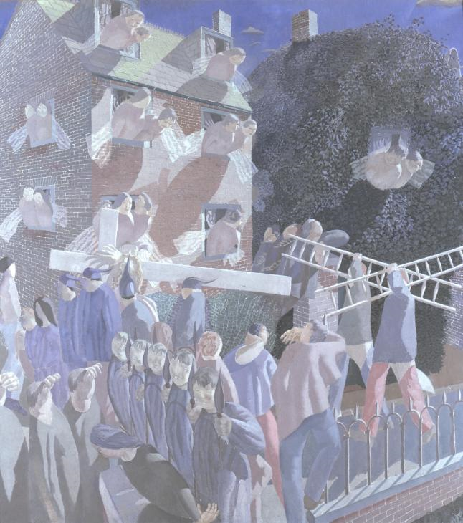
Stanley Spencer, Christ Carrying the Cross http://www.tate.org.uk/art/artworks/spencer-christ-carrying-the-cross-n04117

Slide 9
Pieter Bruegel the Elder, The Procession to Calvary, oil on canvas (124 × 170 cm) 1564
Museum Kunsthistorisches Museum, Vienna, http://www.artbible.info/art/large/266.html

Slide 10
The Mill and The Cross (2011) Movie Trailer HD
https://www.youtube.com/watch?v=1ZeCX_zevJ0

Slide 11
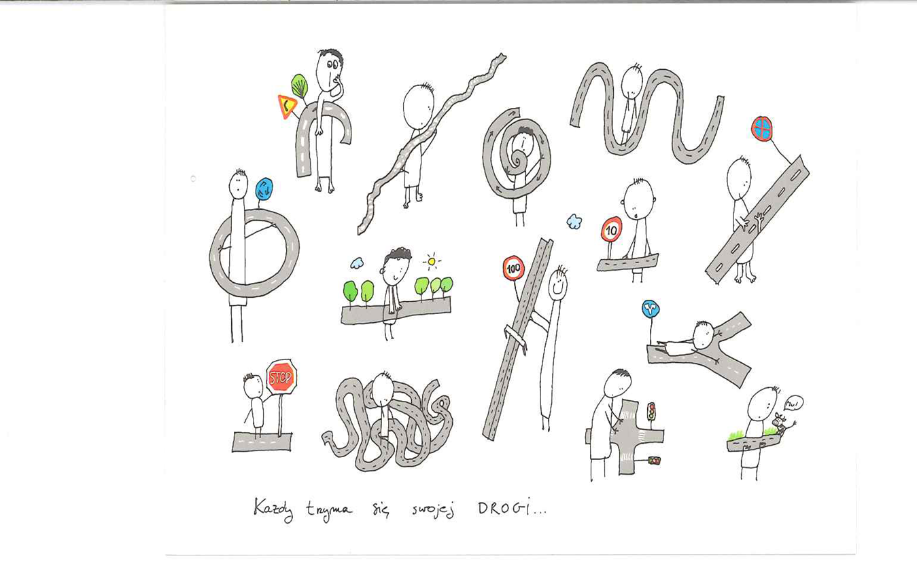
Perfecting Humanity

Slide 12
SALVATION?
S – Sacrament of Fulfilment (Ongoing/Eschatological)
A – Awakening (the moral and spiritual self); recognition of the lack in us/our incompleteness
L – Love (perfects our humanity; fulfils the lack in us).
Life on earth has significance and we have a fundamental role to play in our salvation.
V – Virtue (a disposition of mind that enables us to live and act rightly; right habit; right behaviour)
A – Attention (being in the moment, having eyes open)
T – Transformation (continuous and ongoing with sin and vice as its material)
I – Integrity (bringing everything together under God)
O – Openness (to God, to the Other, to Oneself, to Life)
N – Natural and Super-Natural (achievement and God’s work in us); ‘supernatural existential’ (Rahner)

